Slide 1
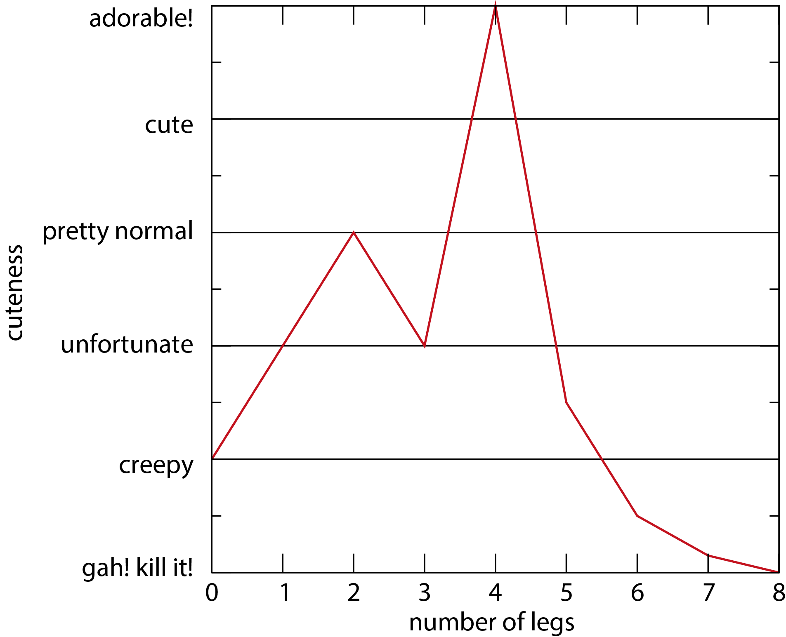
Using python to prepare beautiful, effective scientific figures Part I: What are the hallmarks of a good vs bad figure?
Taylor D. Sparks,
Materials Science and Engineering,
University of Utah

Slide 2
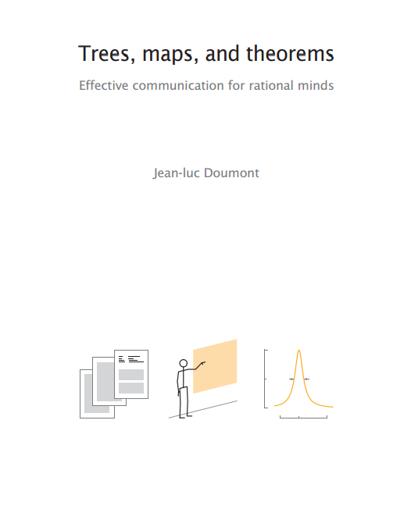
There are many great resources available, I’m just presenting my opinion!
go watch Jean Luc Doumont
Tiny.cc/doumont
and his book Trees, maps, and theorems
http://www.treesmapsandtheorems.com
Also check out Ram Seshadri’s excellent guides on figures
http://www.mrl.ucsb.edu/~seshadri/PreparingFigures-February2020.pdf

Slide 3
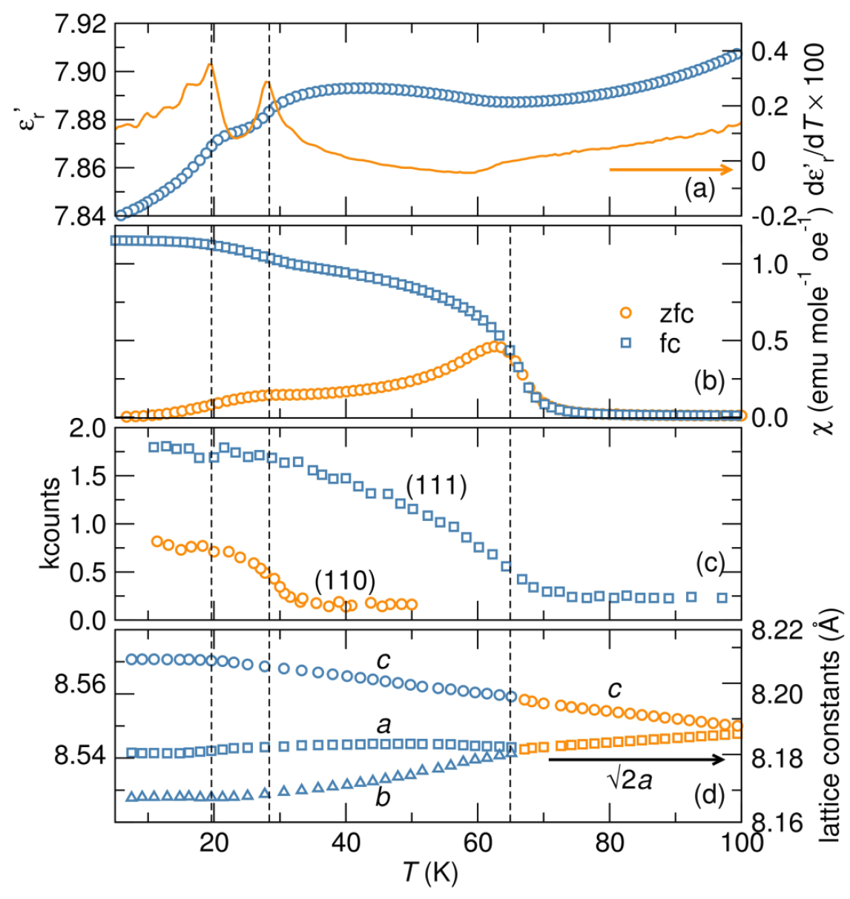
Graphical excellence is well-designed, interesting data*
An effective figure will take a complicated idea and portray it with clarity, precision, and efficiency.
*pg. 51, Tufte, Edward R. The Visual Display of Quantitative Information; Graphics Press: Cheshire, CT, 1983; pp 1‐197.

Slide 4
Many default plotting programs make surprisingly bad plots
Why do we have a chart title?
Why is the legend off the plot?
Where are the x-axis tick marks?
Difficult to see different measurement data points
Font size irregular
x-axis label formatting is bad
Colors are unimaginative
Markers and line stroke are uniform when they could differentiate data sets
5 inches

Slide 5
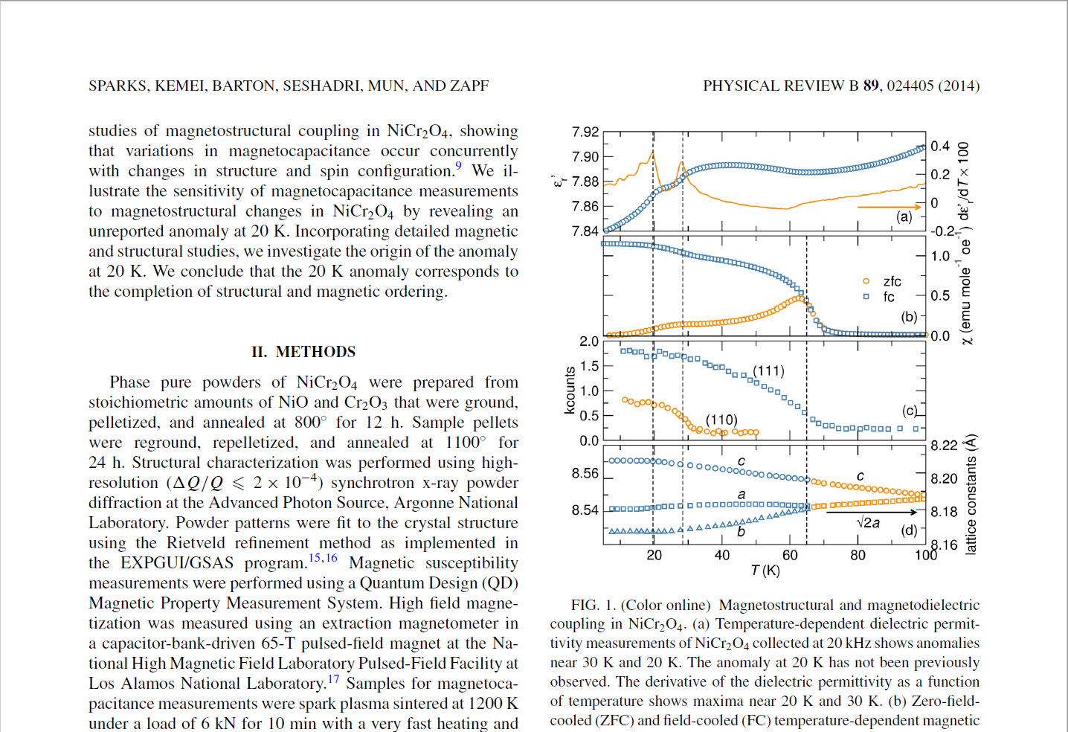
Most scientific publications use two-column format which shrinks width of figures

Slide 6
Most scientific publications use two-column format which shrinks width of figures
8.5 inches
3.5 inches

Slide 7
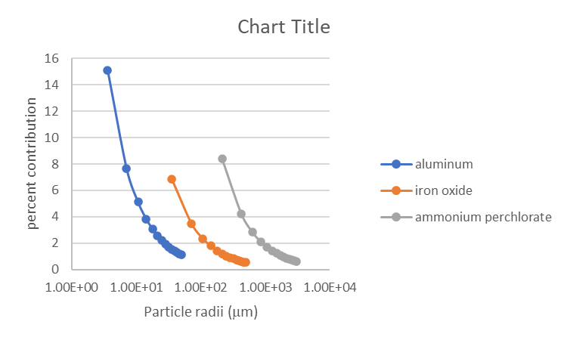
Default plots look even worse when they get shrunk down
3.5 inches

Slide 8
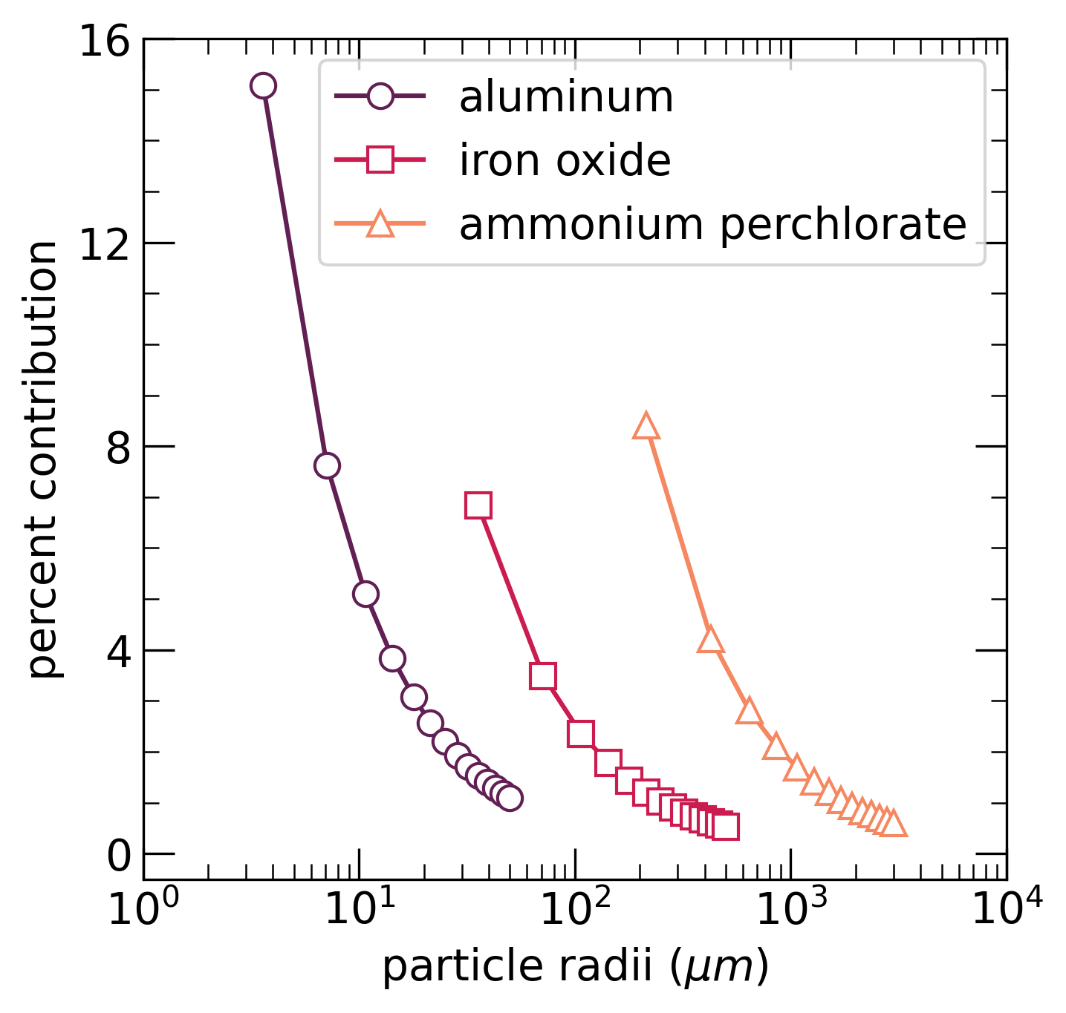
Now consider a nice figure
No chart title needed (usually)
Legend within the plot area
Ticks are uniform on both axes
Individual measurements visible
Font size uniform
x-axis label formatting is great
Colors are beautiful
Markers are unique to each data set
5 inches

Slide 9
It shrinks gracefully because we used a square figure with an internal legend
3.5 inches

Slide 10
Side-by-side comparison makes improvement obvious
3.5 inches

Slide 11
What makes a color a good choice?
Makes it easier for a viewer to interpret the data
Draws attention to the appropriate parts of the data
Is accessible to all viewers
Is aesthetically pleasing and beautiful

Slide 12
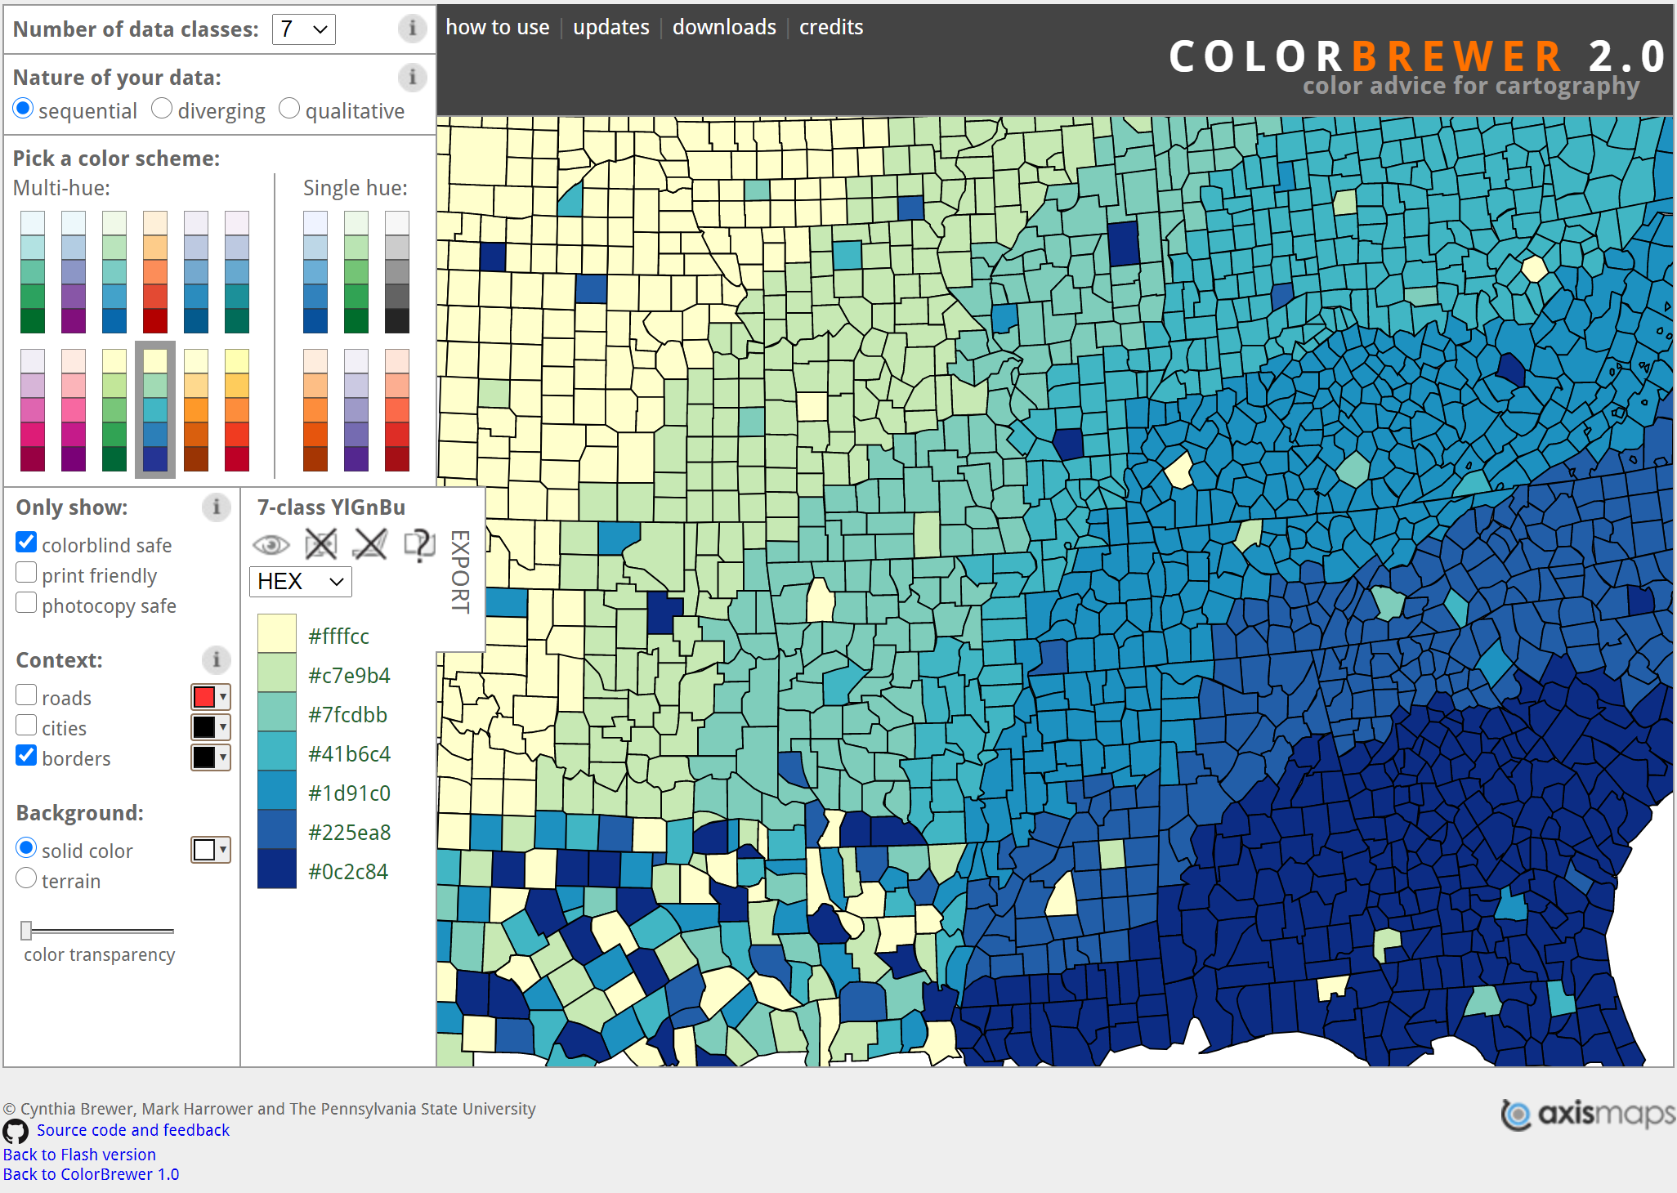
Colorbrewer2.org makes color selection pretty simple

Slide 13
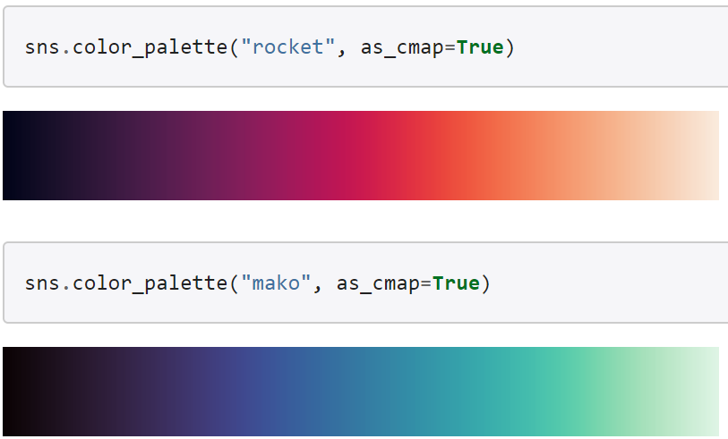
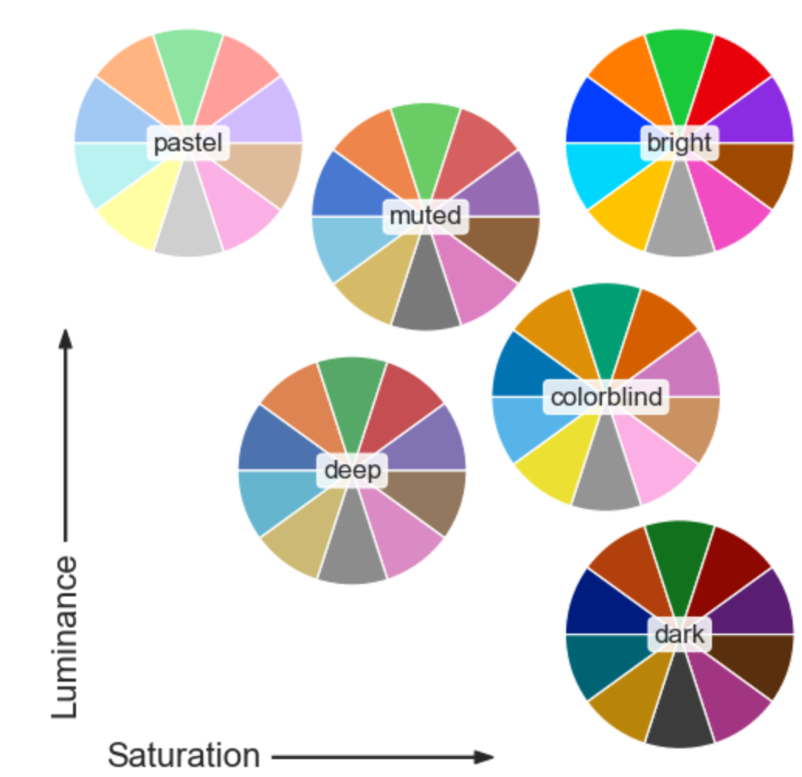
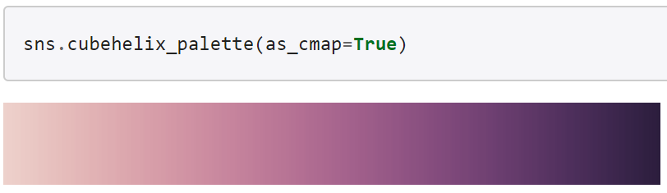
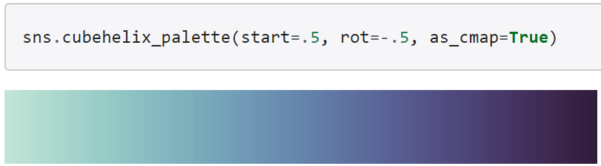

Seaborn library has many wonderful color choices

Slide 14
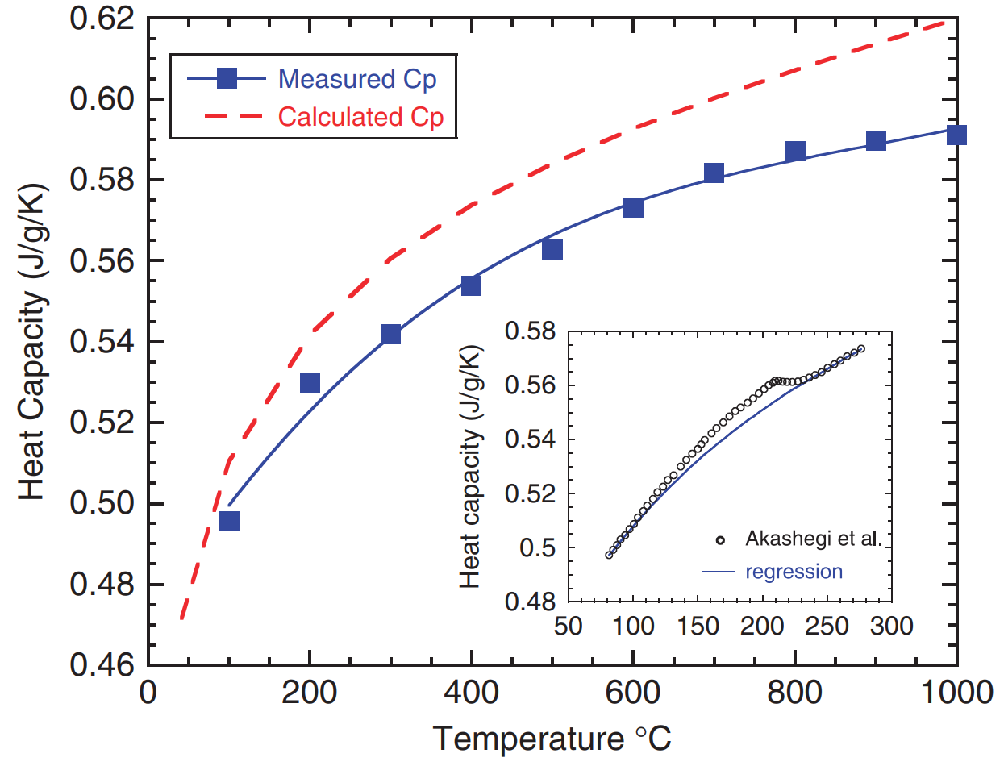
Insets are usually done poorly
5 inches

Slide 15

Insets are usually done poorly
from Sparks’ very first paper
3.5 inches

Slide 16
Another bad figure
Orange data set looks nearly flat
Both data sets nearly overlap with the x-axis
5 inches

Slide 17
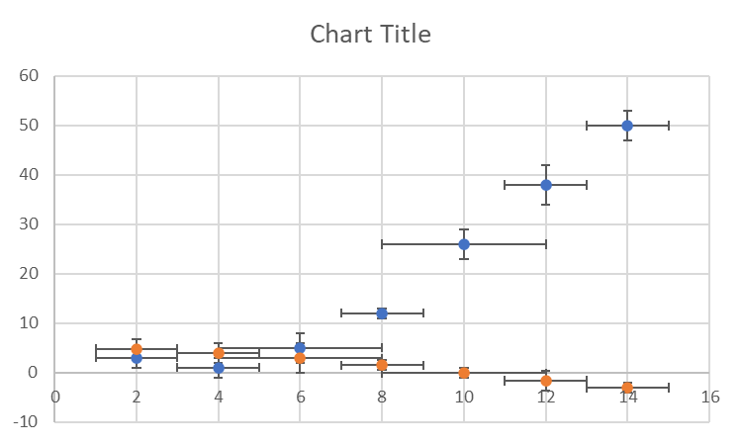
Another bad figure… is made worse in two-column format
3.5 inches

Slide 18
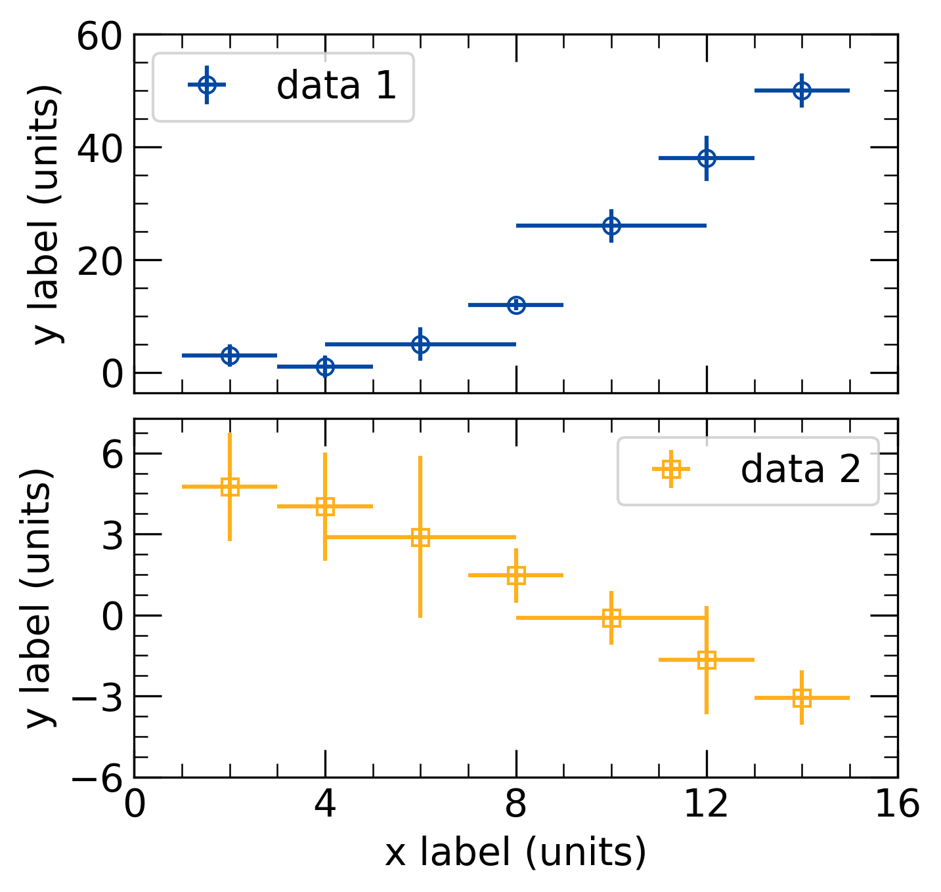
Multipanel plots make a great alternative to insets!
Multipanel plots let us see the trends for both data clearly
5 inches

Slide 19
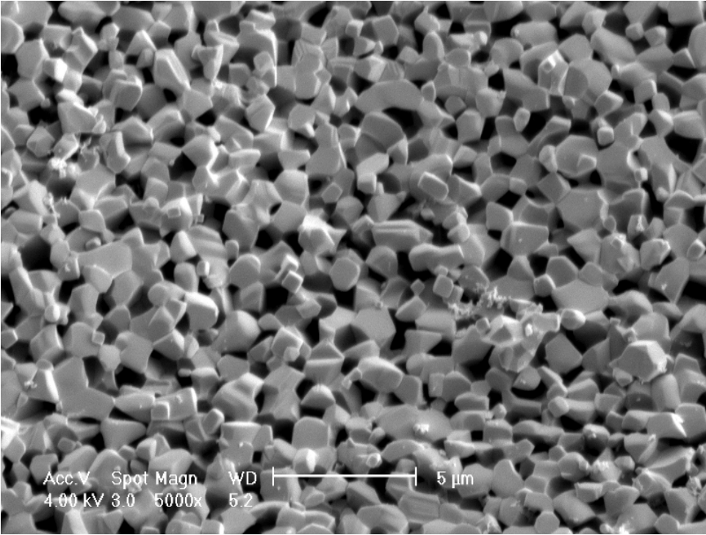
Micrographs need editing as well
Do we really need all the superfluous information?
We can make these square as well!
Scale bar can’t be read and it’s the most important thing to read!
5 inches

Slide 20
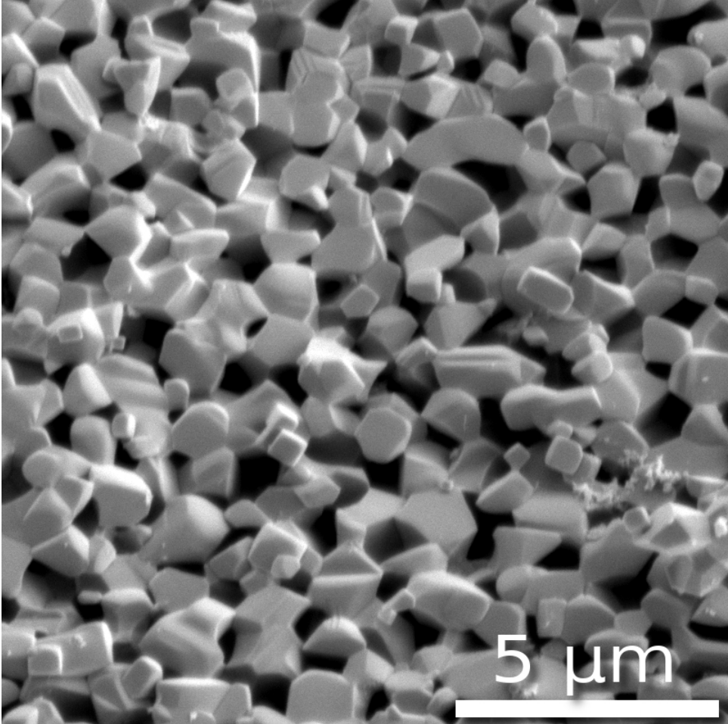
Micrographs need editing as well
Remove the nonsense
Crop image square
Accurately draw your own scale bar
5 inches

Slide 21
Let’s consider some nice examples

Slide 22
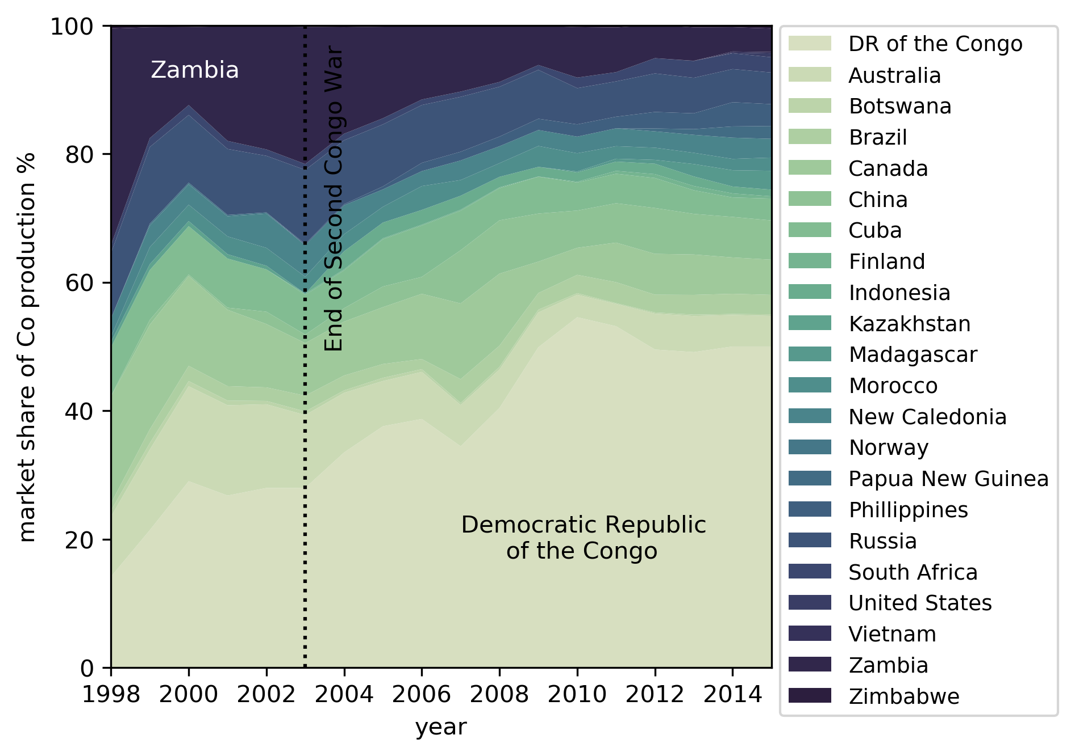
Let’s consider some nice examples

Slide 23
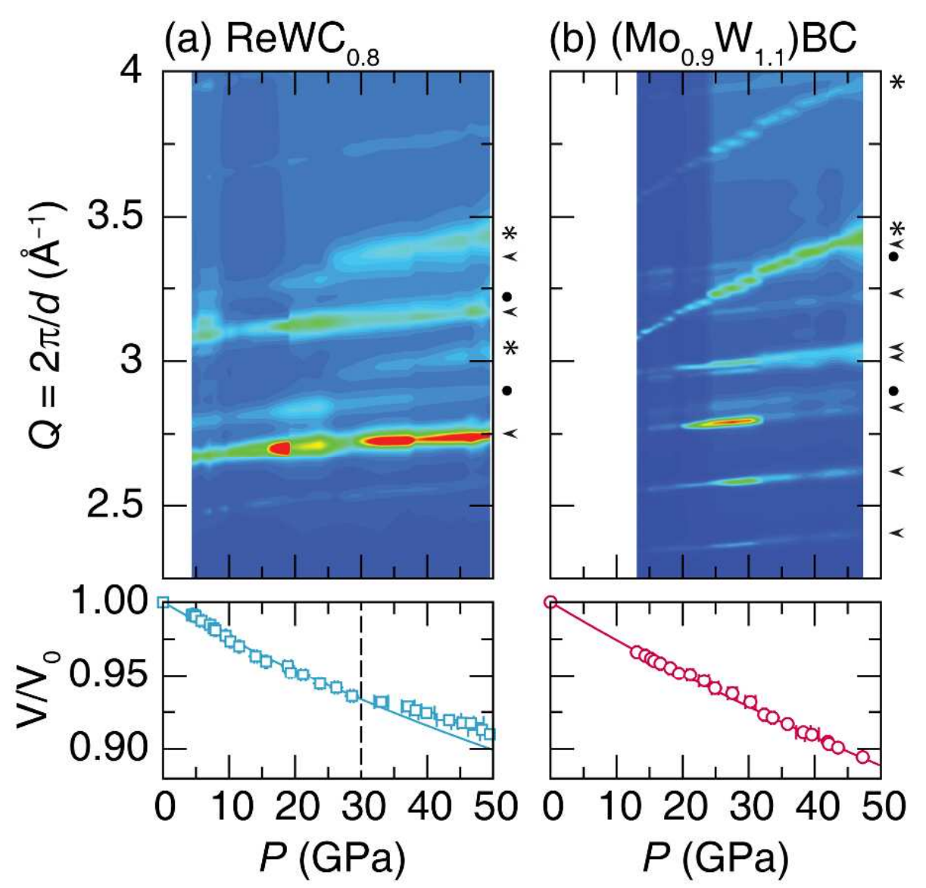
Let’s consider some nice examples

Slide 24
Let’s consider some nice examples

Slide 25
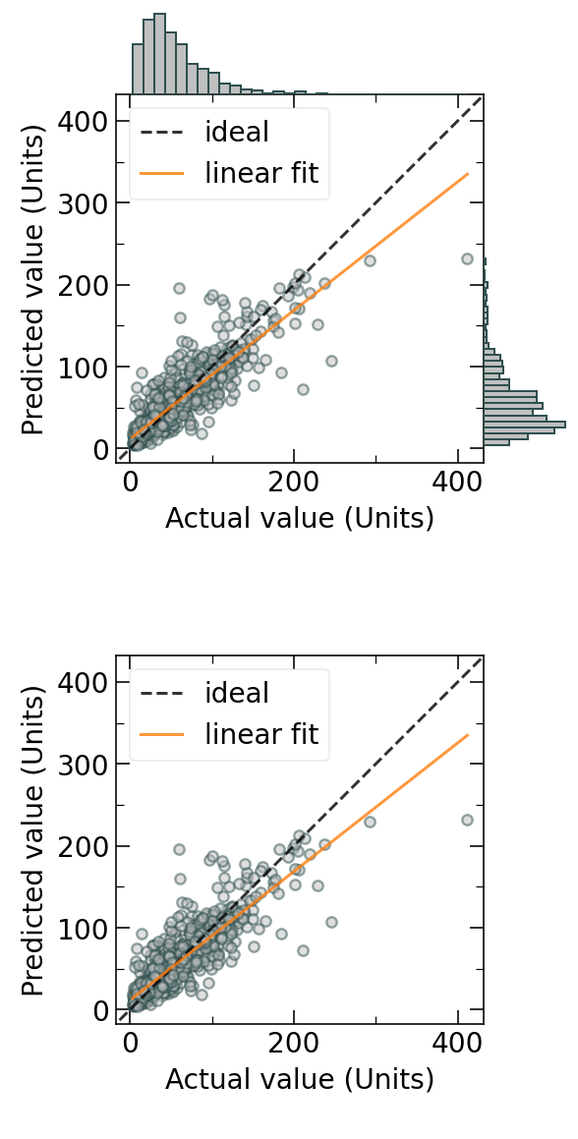
Let’s consider some nice examples

Slide 26
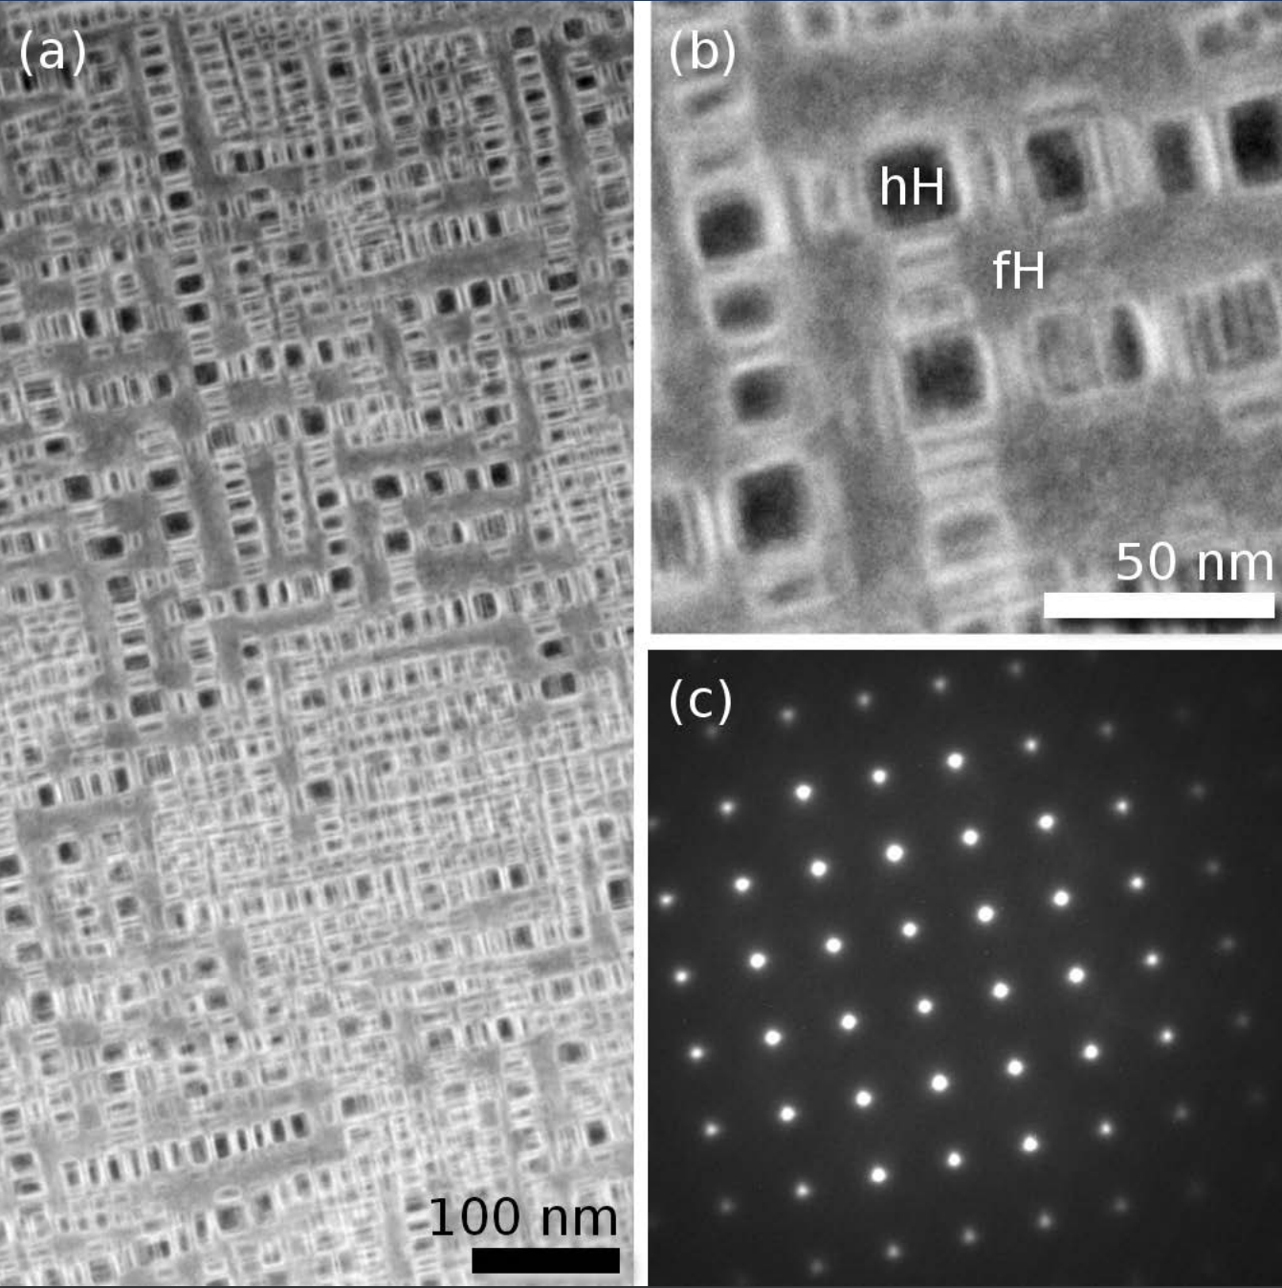
Let’s consider some nice examples

Slide 27
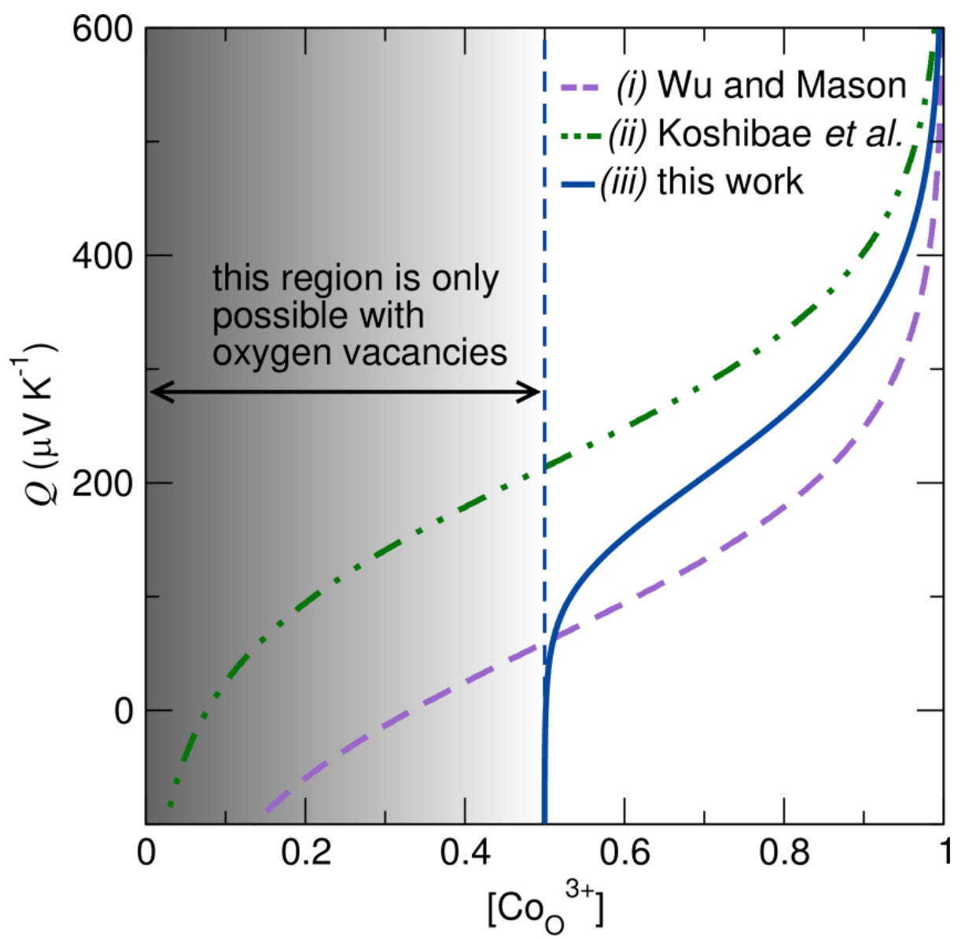
Let’s consider some nice examples

Slide 28
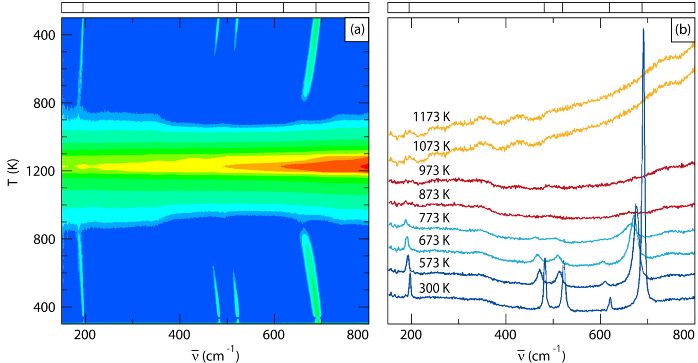
Let’s consider some nice examples

Slide 29
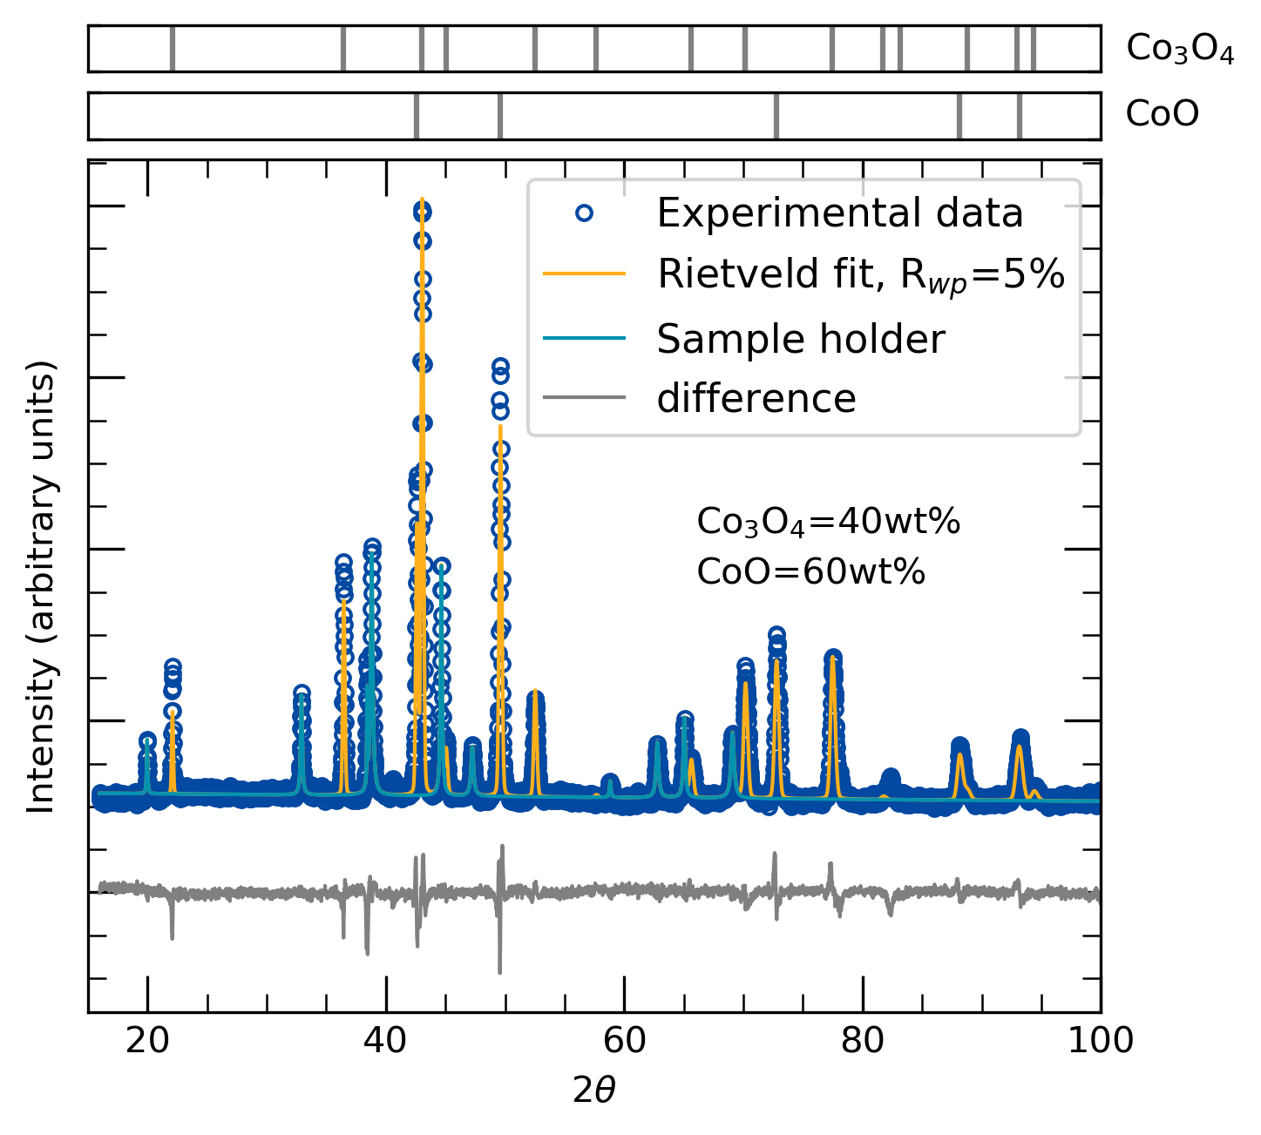
Let’s consider some nice examples

